Slide 1

FLIGHT DELAY PREDICTION DATA SET
Vihar Devalla PES2UG19CS453
Toshani Rungta PES2UG19CS433
Srinivasa Raghavan PES2UG19CS407
Syed Mohammad Hussain PES2UG19CS424

Slide 2
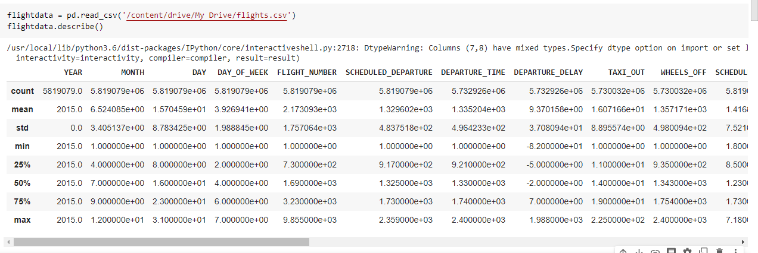
DESCRIPTION OF DATA SET
Number of rows = 5819079
Number of columns = 31
% of Null/NaN Values = Approx. 3%

Slide 3
DATA CLEANING
Data cleaning is the process of ensuring that your data is correct, consistent and useable by identifying any errors or corruptions in the data, correcting or deleting them, or manually processing them as needed to prevent the error from happening again.
It has been recorded in surveys that a data scientist takes 80% of his time in finding appropriate data and cleaning it.
In data cleaning, we deleted both – the columns with very high NaN values and rows with the missing/NAN values. We also dropped columns that have no purpose in the analysis. We used a library named pandas plays in data cleaning as it has many in-built functions that can be used in the process.

Slide 4
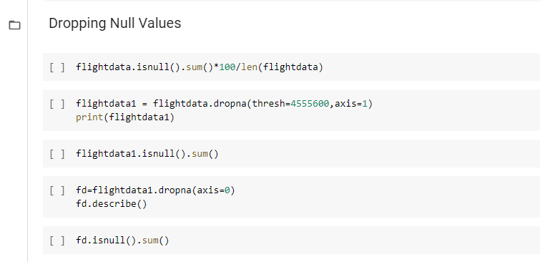

Slide 5
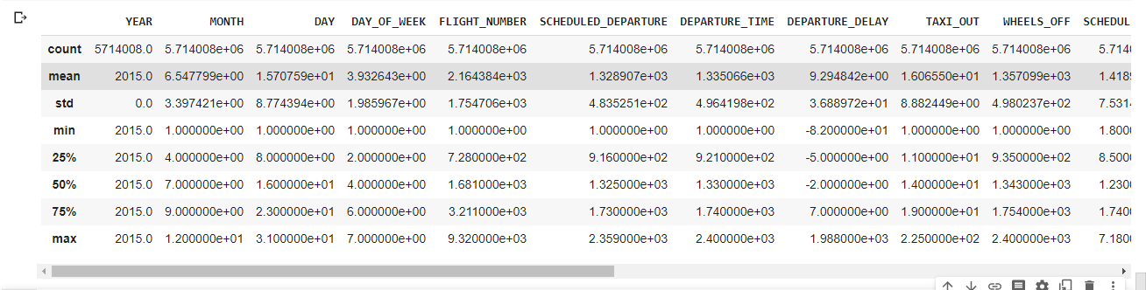
After Cleaning

Slide 6
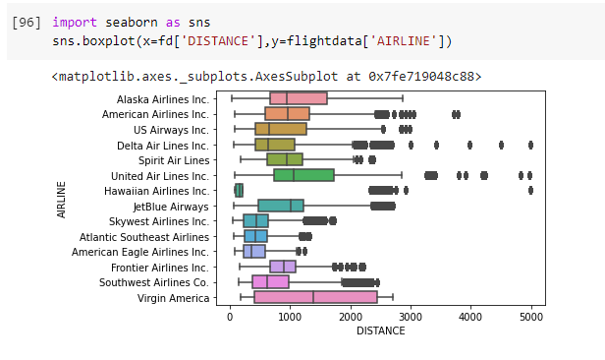
EDA – WITHOUT STANDARDIZATION OR NORMALIZATION
Box Plot

Slide 7
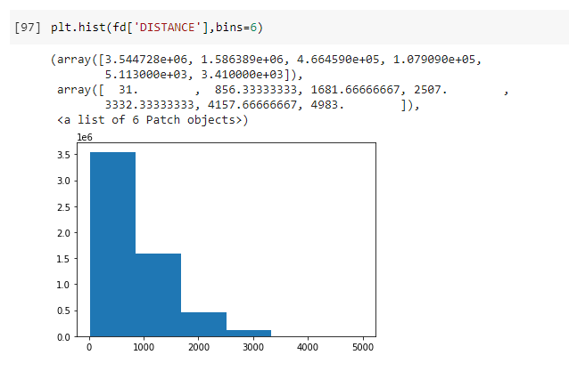
Histogram

Slide 8
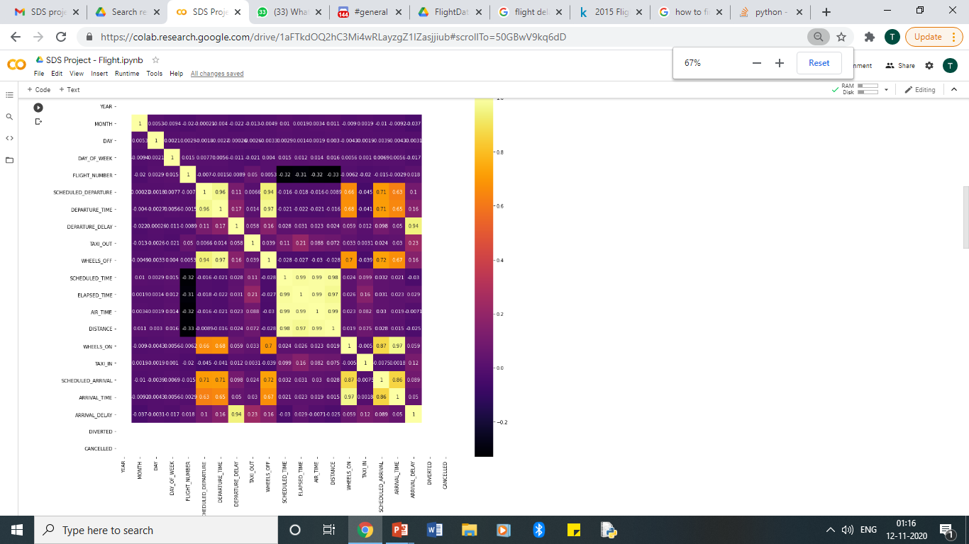
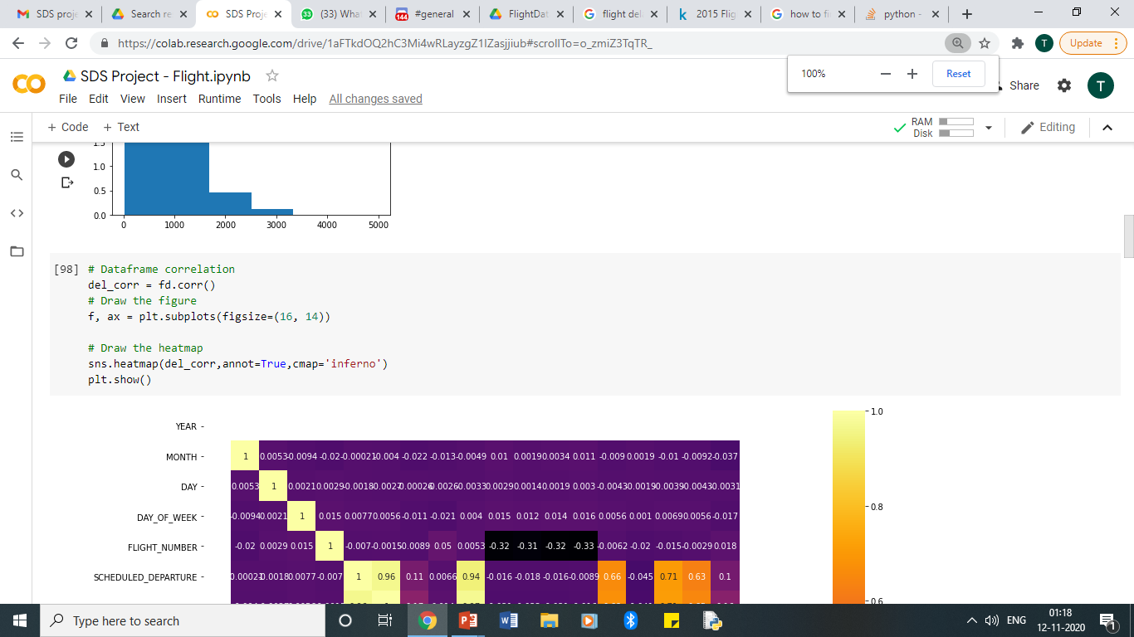
Heat Map

Slide 9
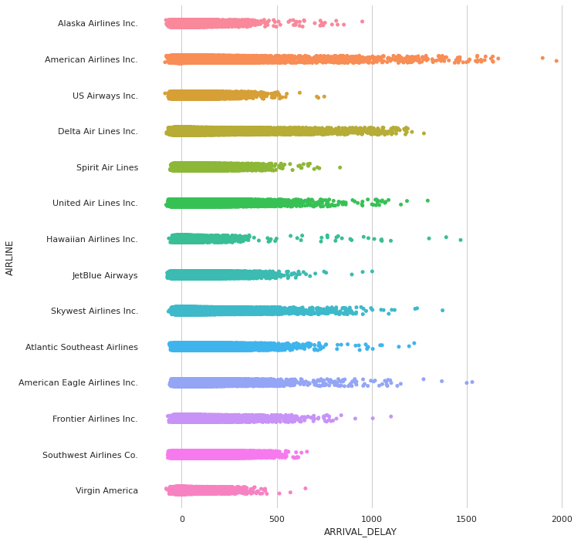
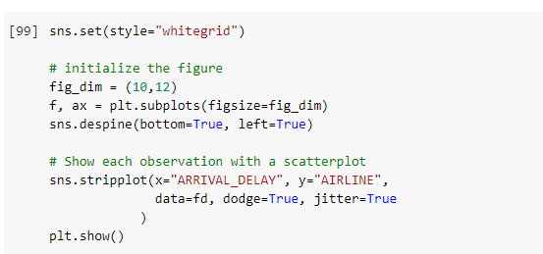
Strip Plot

Slide 10
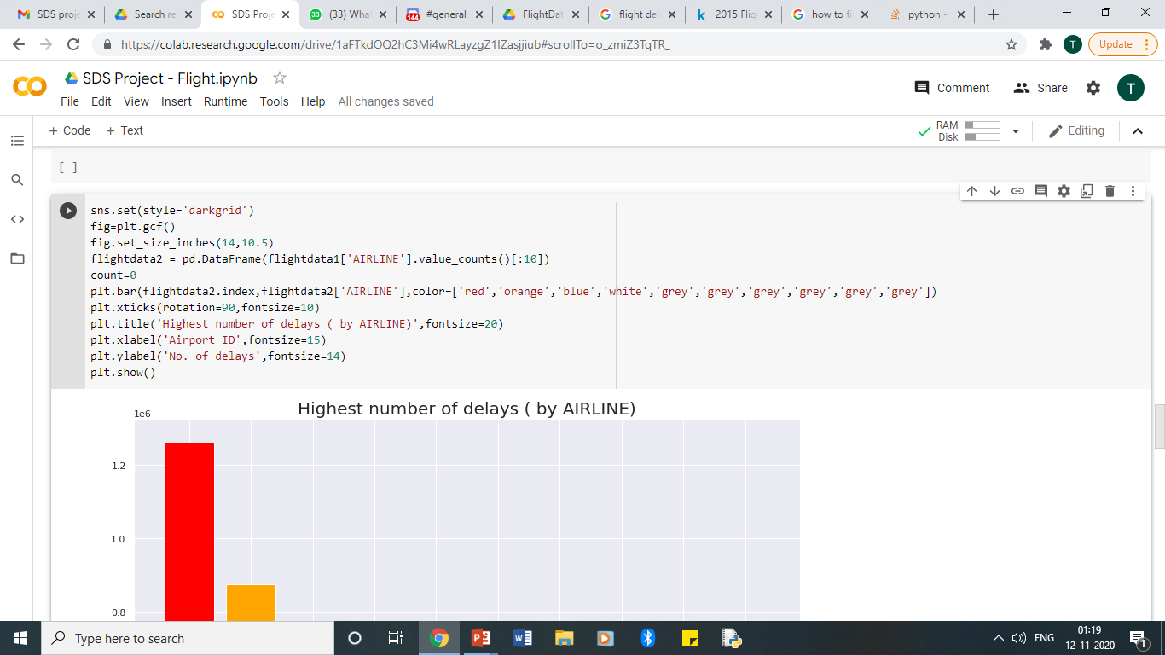
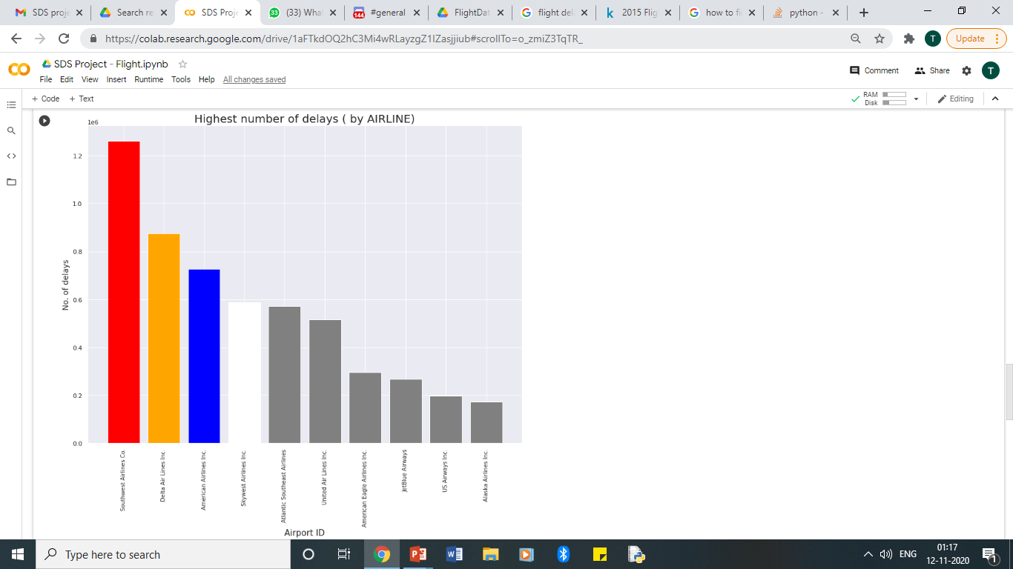
Bar Graph

Slide 11
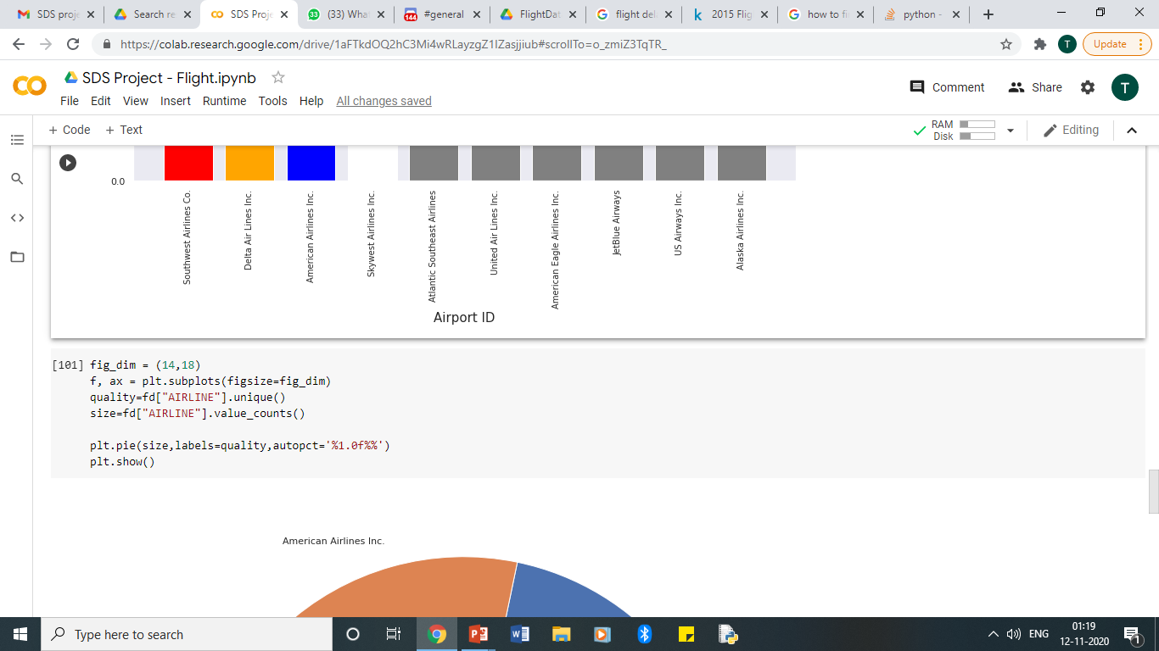
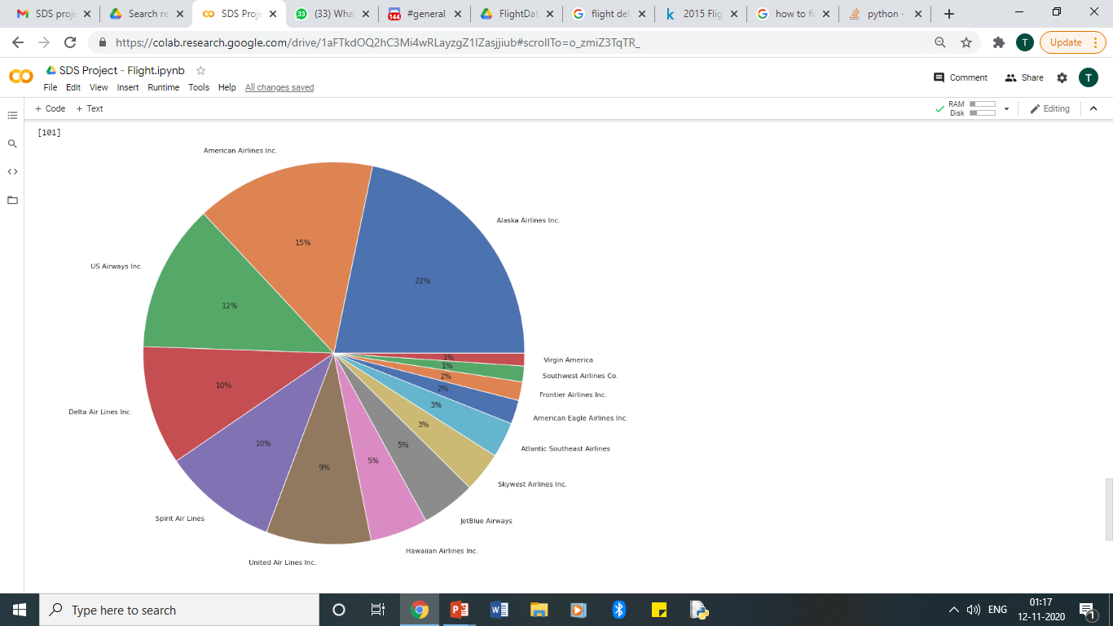
Pie Chart

Slide 12
STANDARDIZATION AND NORMALIZATION
Normalization is a part of the process of data preparation for machine learning. The aim of normalization is to change the values of numeric columns in the dataset to a common scale, without distorting differences in the ranges of values. It is necessary only when features have different ranges.
Normalization rescales the values into a range of [0,1] whereas standardization rescales values to make it’s mean 0 and its standard deviation equal to 1.

Slide 13
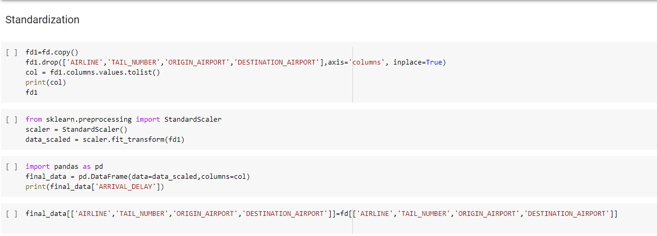

Slide 14
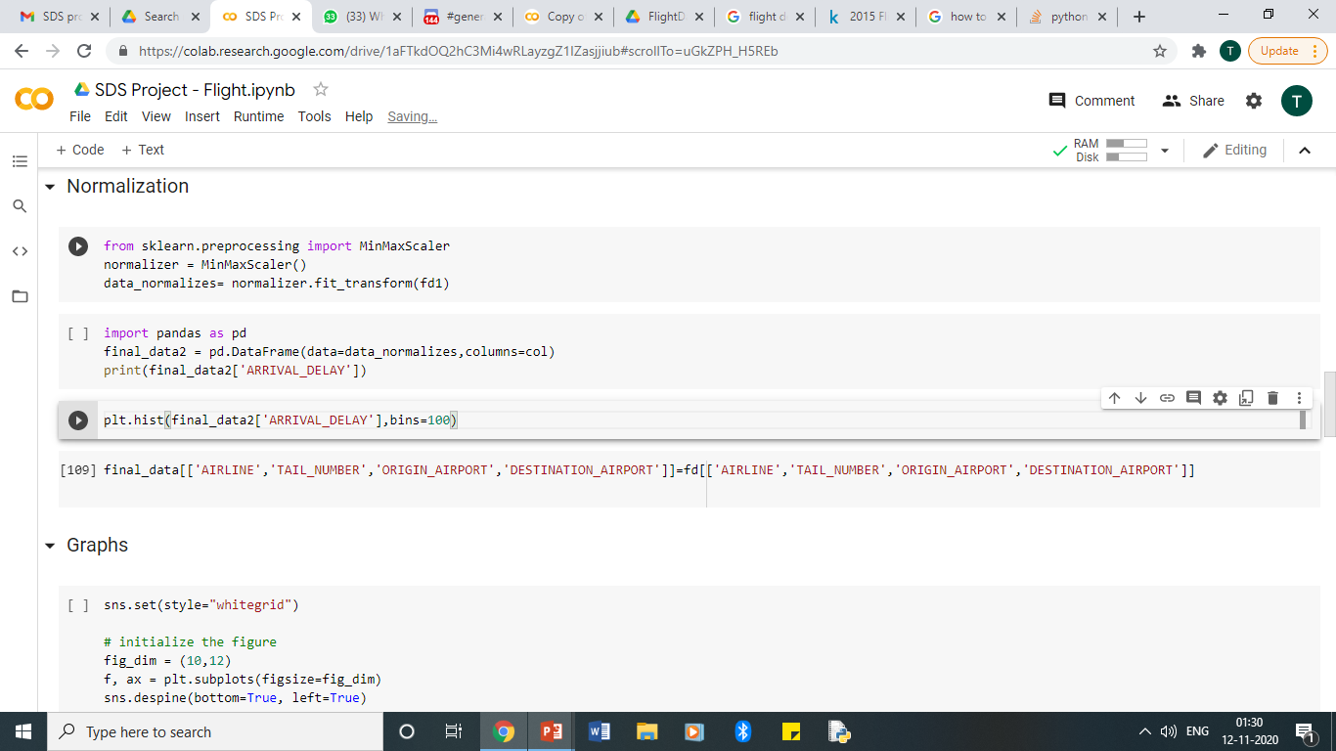
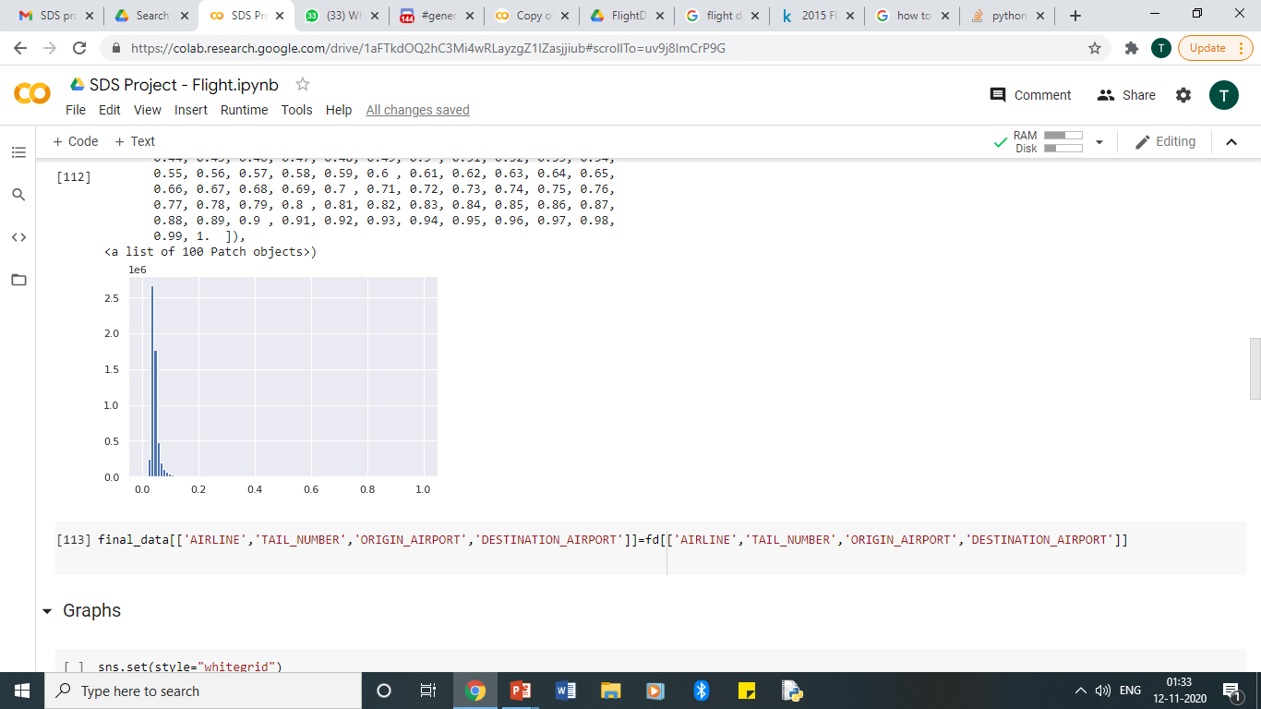

Slide 15
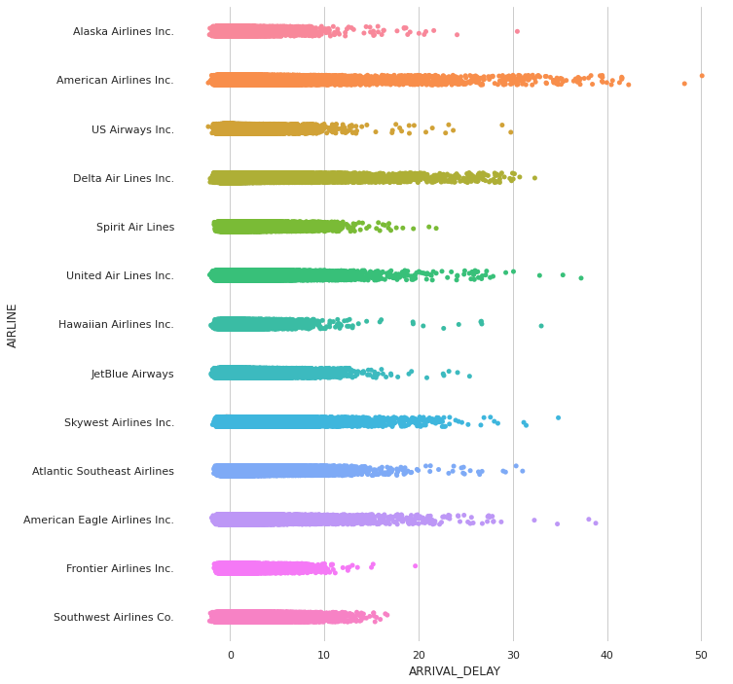
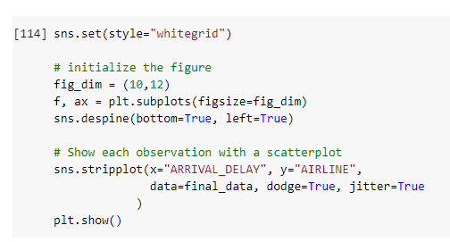
EDA – WITH STANDARDIZATION AND NORMALIZATION
Strip Plot

Slide 16
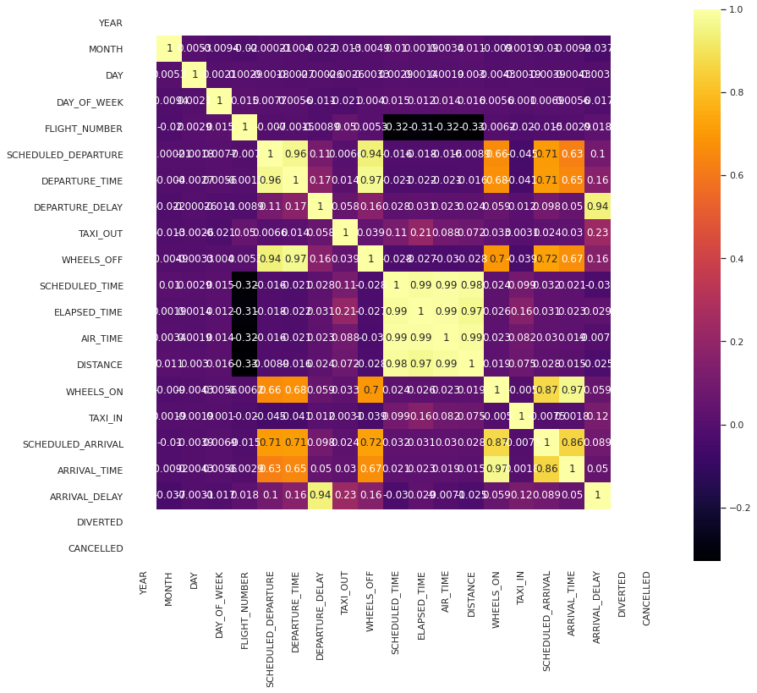
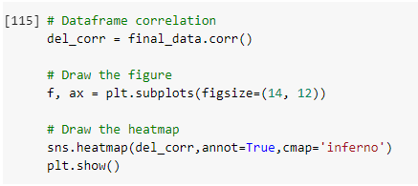
Heat Map

Slide 17
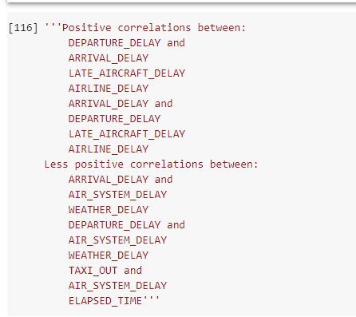
Observations

Slide 18
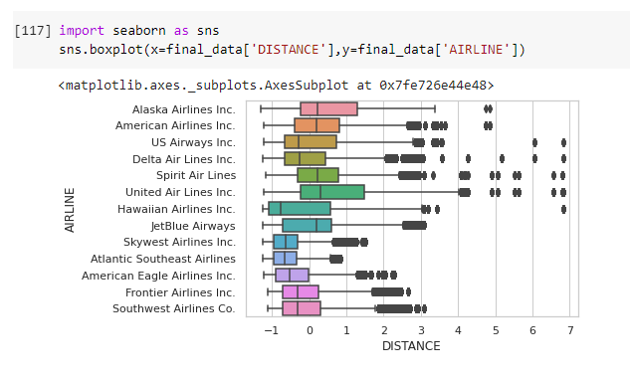
Box Plot

Slide 19
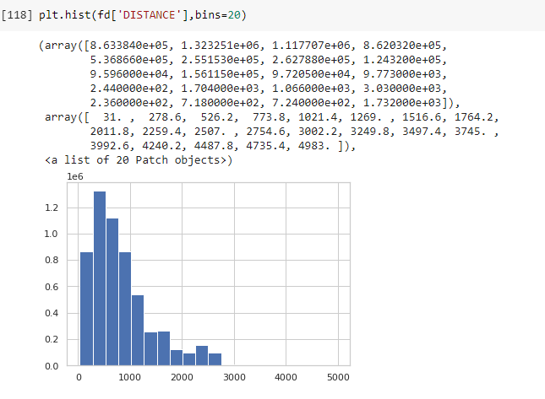
Histogram

Slide 20
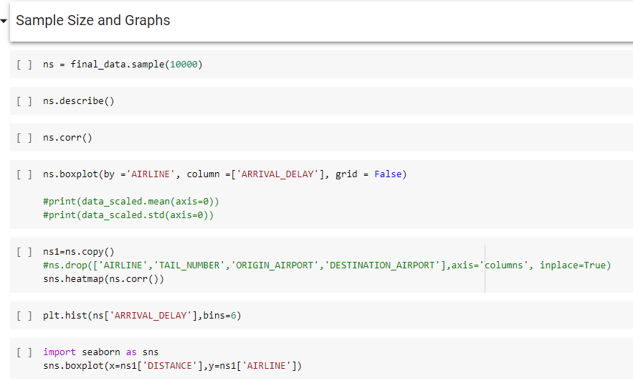
SAMPLING

Slide 21
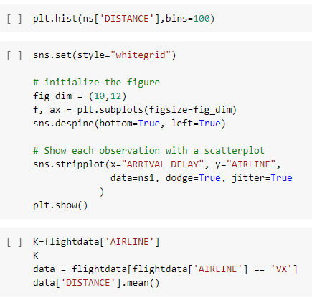

Slide 22
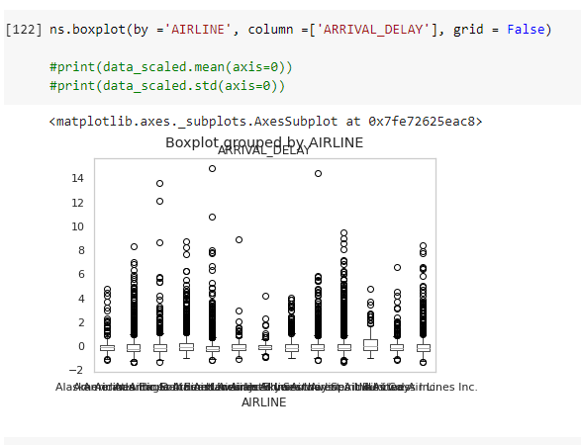
Box Plot

Slide 23
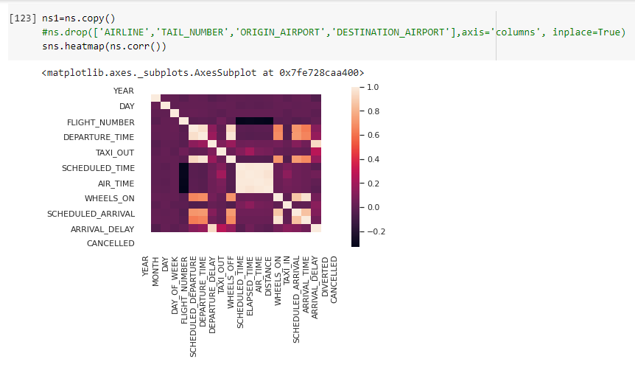
Heat Map

Slide 24
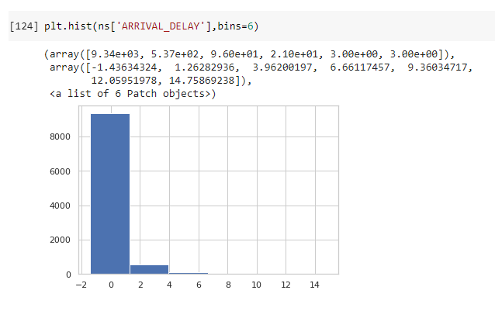
Histogram

Slide 25
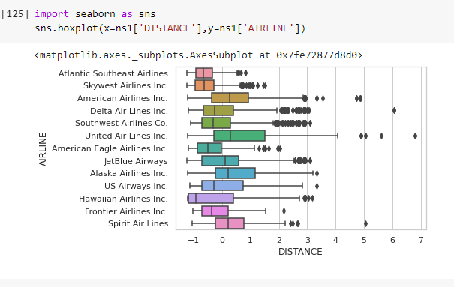
Box Plot

Slide 26
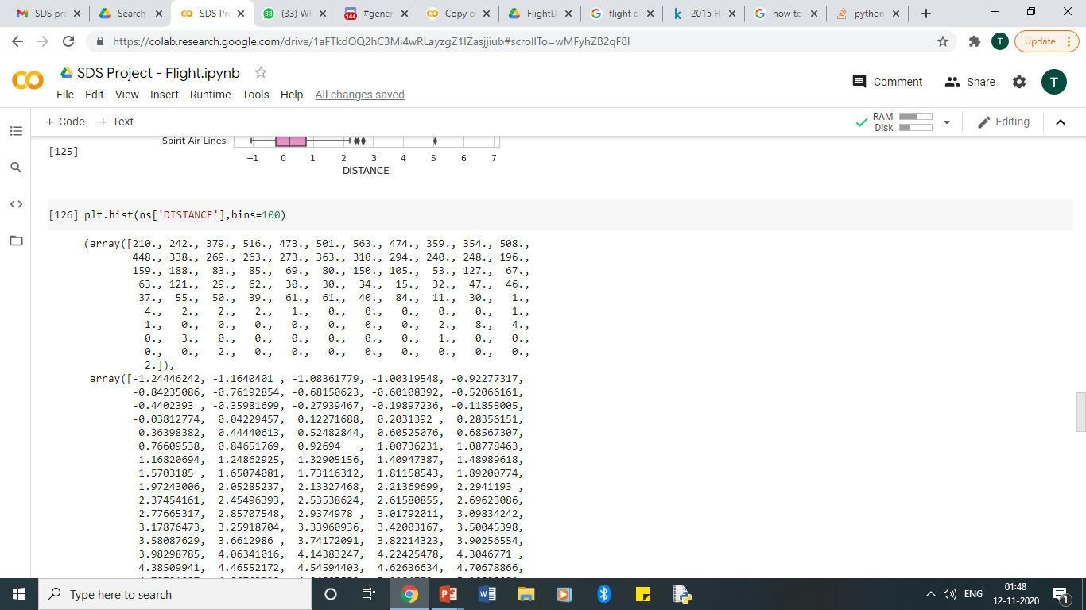
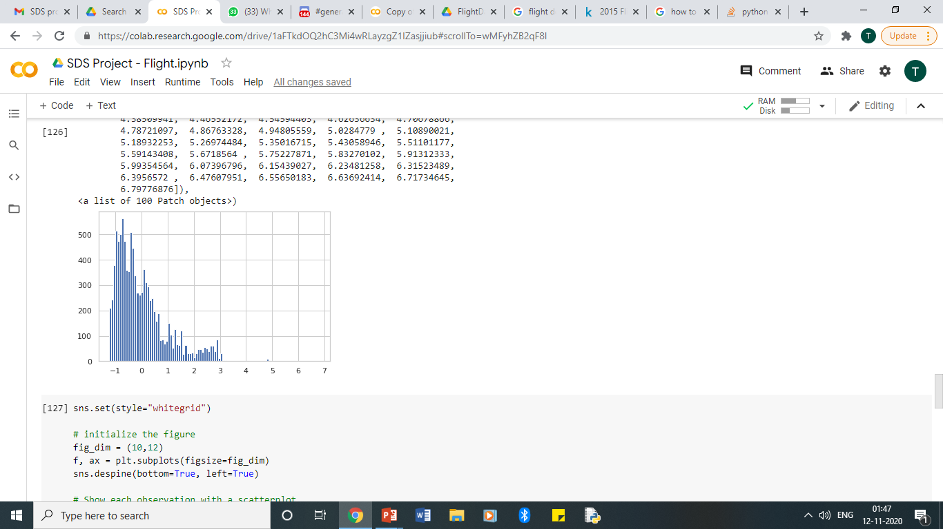
Histogram

Slide 27
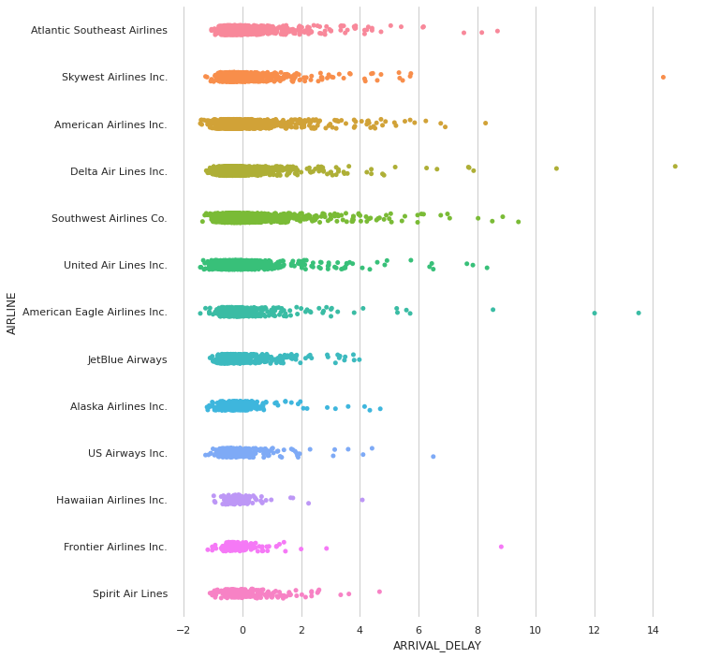
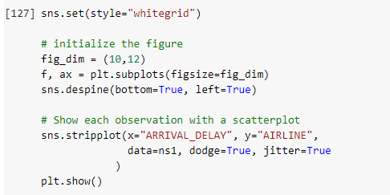
Strip Plot

Slide 28
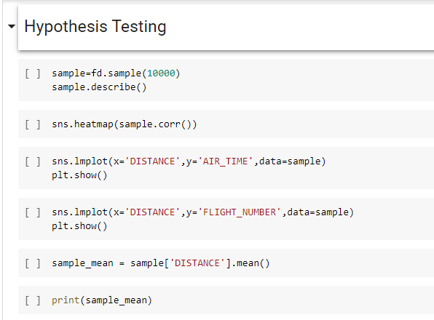
HYPOTHESIS TESTING

Slide 29
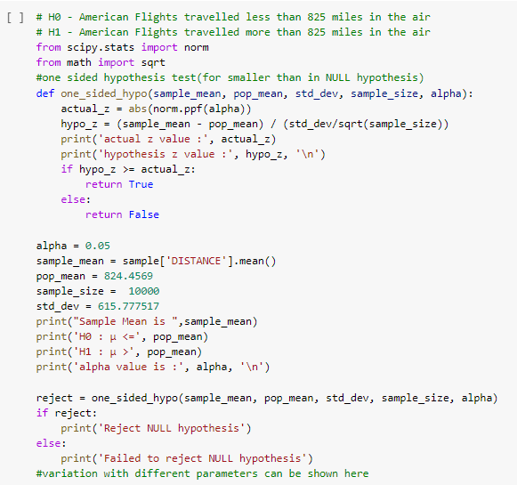

Slide 30
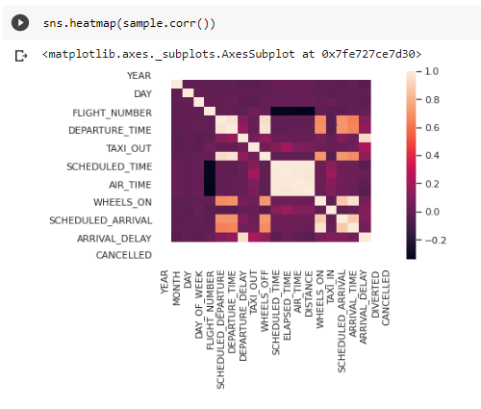
Hypothesis Testing Output Heat Map

Slide 31
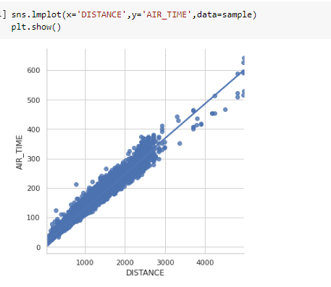
Hypothesis Testing Output Line Map

Slide 32
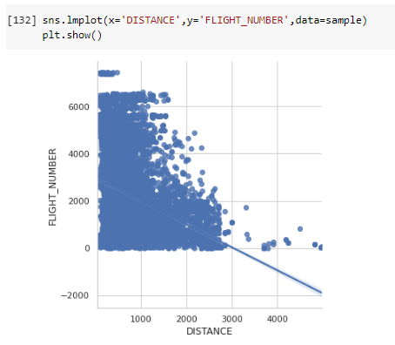
Hypothesis Testing Output Line Map

Slide 33
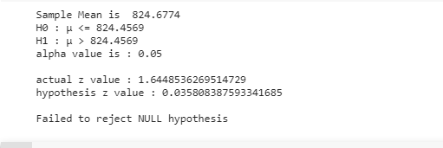
Hypothesis Testing Output – Final Result

Slide 34
THANK YOU!

